Slide 1
Efficient, Joint-Based Skeleton Action Recognition
Nicolas Fleece, S# 8327287 Supervisor – Dr. Robert Laganière

Slide 2
Thesis Aim
Develop a robust lightweight pose-based action recognition framework that has reasonable accuracy and is resistant to changes in the background.
Notes:
- This is the aim of the thesis

Slide 3
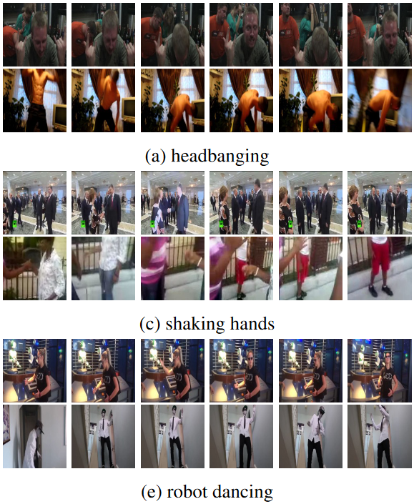
Action Recognition
Complex problem with many different challenges
Background information is constantly changing such as the camera moving, or people moving around in the background not related to the main action
Two people may not perform an action the same way, i.e. walking up stairs, jumping, catching a ball

Slide 4
Motivations
Issues with current models
Too Large
Susceptible to background interference
Notes:
- Large models such as the ones developed my Microsoft, Facebook, etc. cannot be run on less modern hardware -- smartphones
- Smaller models are better, but are often susceptible to some background interference which makes them difficult to run in the wild
- So we aim to solve both these problems with a small model invariant to most kinds of background interference

Slide 5
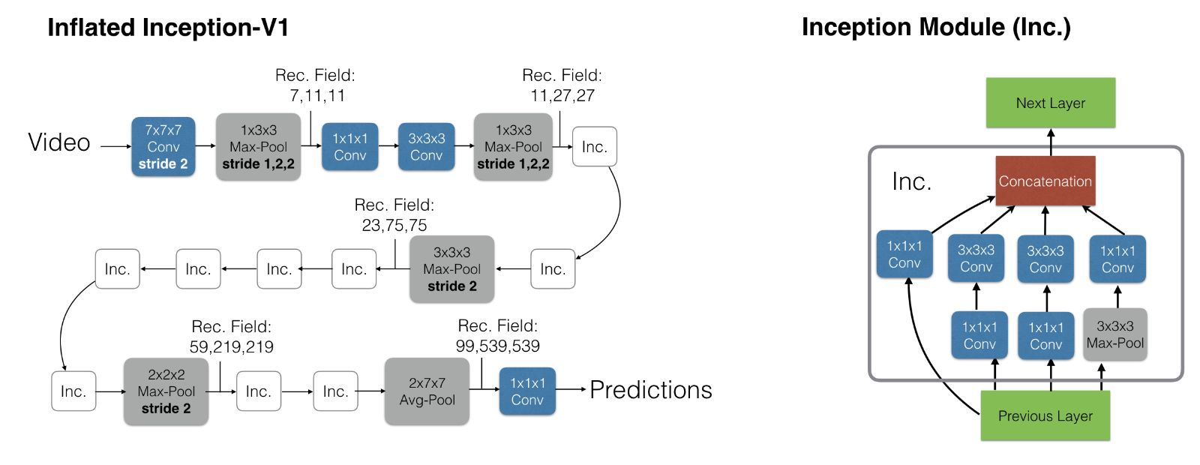
Large Action Recognition Models – I3D

Slide 6
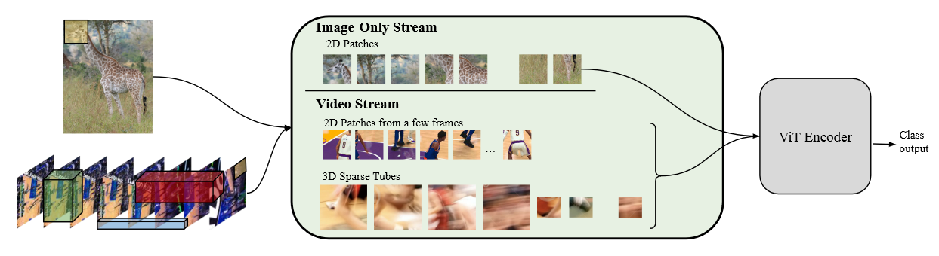
Large Action Recognition Models - TubeViT
Large Model

Slide 7
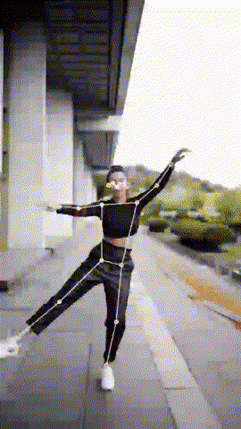
Pose
Pose is crucial to avoiding background interference
Existing lightweight 2-D pose models have proven effective
Potential background interference introduction
Not relevant in our analysis as will be explained later
All pose models subject to this same interference
Notes:
The answer to this question is to turn to pose
Pose allows us to focus on the movements of the person and filter out some of the background
The pose models available to us today have proven to be rather good at extracting this 2 dimensional pose
however it’s worth noting that the introduction of these pose models will introduce some error, however for our analysis this won’t be relevant in our analysis for reasons I’ll speak to later

Slide 8
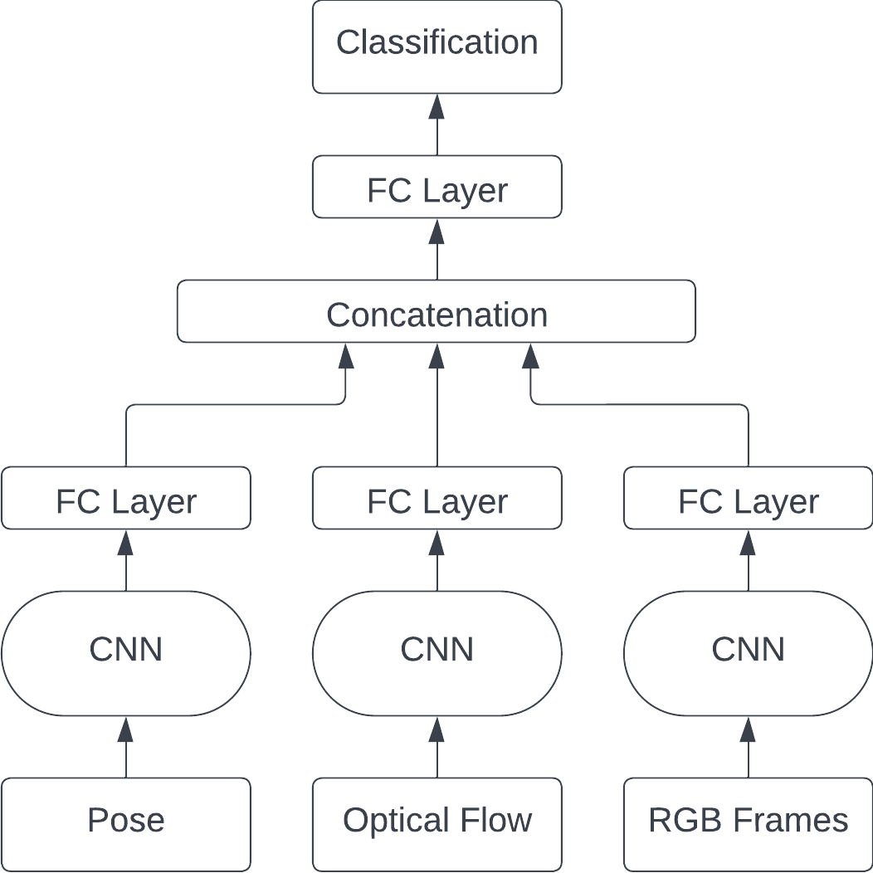
Pose-Based Models
Fused Architecture
Uses Pose, Optical Flow and RGB parts separately, concatenating them at the end
Typically utilize complex 3D-CNNs
Notes:
From this extracted pose we can construct what a classic model might look like, in this case a “fused” architecture
In this model the pose, optical flow, and rgb frames are passed through what is typically a complex 3d cnn and concatenated after to form an output

Slide 9
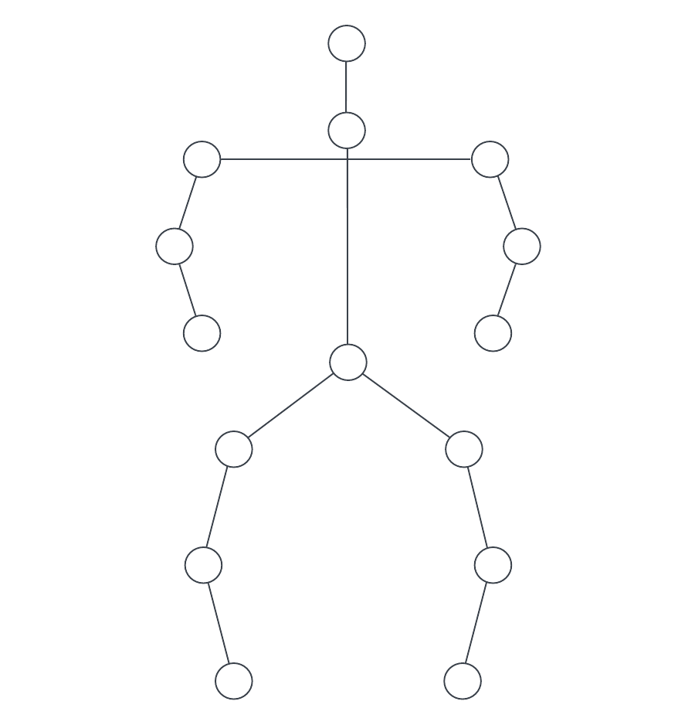
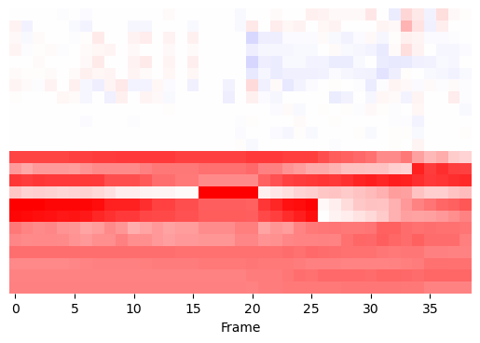
Intermediate Representations
Smaller Model
Notes:
The question of efficiencies start to be raised when it comes to these models and how the pose is processed
Some models choose to construct “intermediate representations” in order to condense the pose data down into a more workable form
This means that the end model used to process the pose data can be much smaller, typically the end goal being a relatively compact 2d cnn

Slide 10
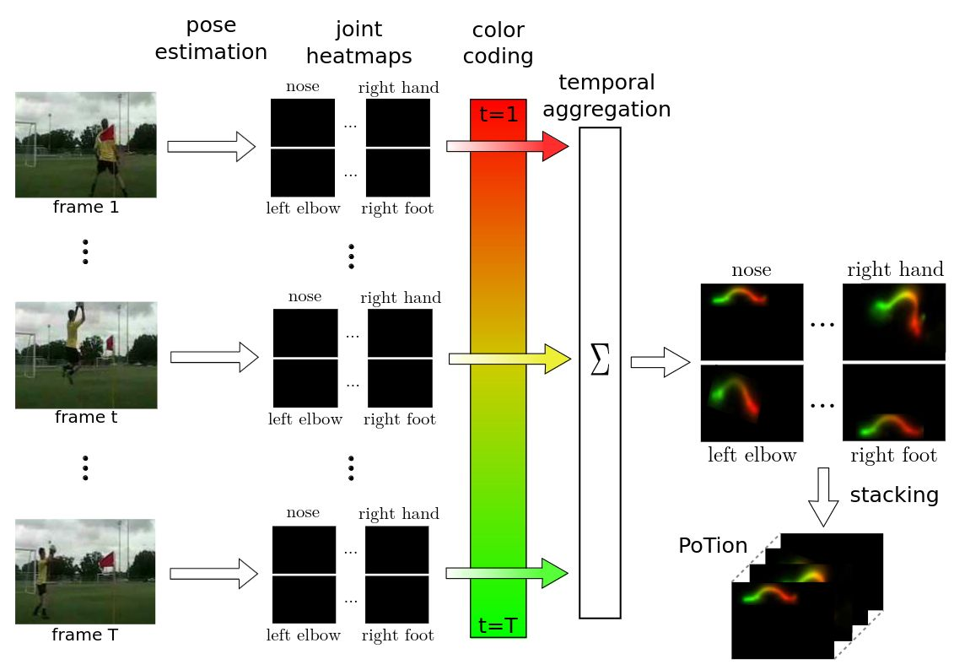
PoTion: Pose MoTion Representation for Action Recognition
The PoTion leverages typical joint heatmaps that are often exported by pose estimation models
Maps individual joints from start to end, assigning them a ‘colour’ based on frame index
i.e. shifts from green → yellow → red
Construction of this image allows for processing using basic 2 Dimensional CNNs
Notes:
An example of an intermediate representation would be PoTion
They use the joint heatmaps at each frame of the image, and using a ‘colorization’ technique where in this case, the joint heatmap at any frame is given a color that transitions from green to yellow to red
These are then combined into one image where there is a line moving through this color coding
These images can then be stacked

Slide 11
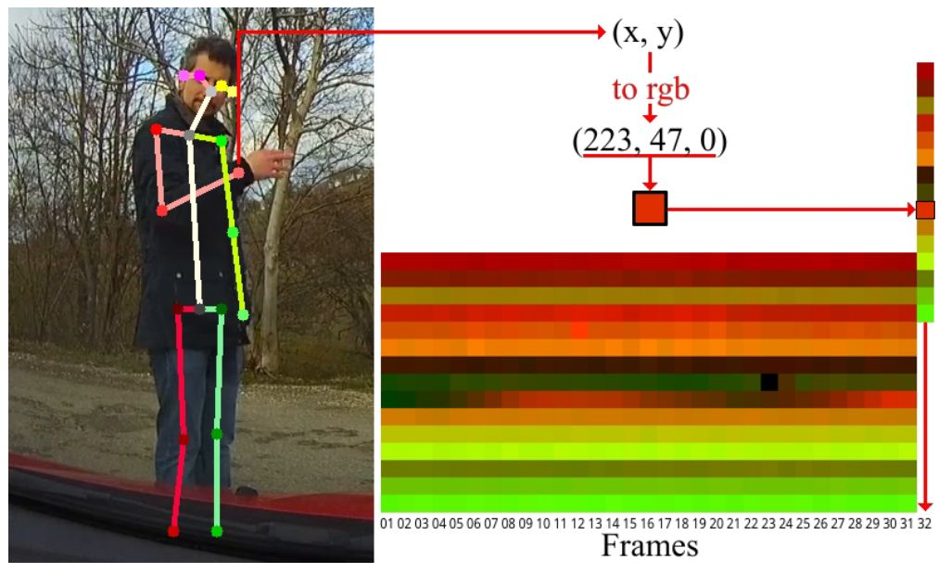
Simple yet efficient real-time pose-based action recognition
This paper proposed the EHPI (Encoded Human Pose Image) representation, which was a direct inspiration for the works in this thesis
Very simple in its construction of a 2-Dimensional “image”
Take x and y positions of the joints, stack them to form one column per frame
Line the stacks up to create an image of the whole video
Problem – Very susceptible to background interference
Notes:
Another intermediate representation that was an inspiration for this work was the Encoded Human Pose Image representation
This representation takes the x and y positions of the person and constructs this 2d image that is shown on the right by stacking each joint position and lining up these columns to represent the whole video.
The primary issue is that this is very vulnerable to things such as camera movement, and if the camera is not completely stationary, can lead to strange movements in the data.

Slide 12
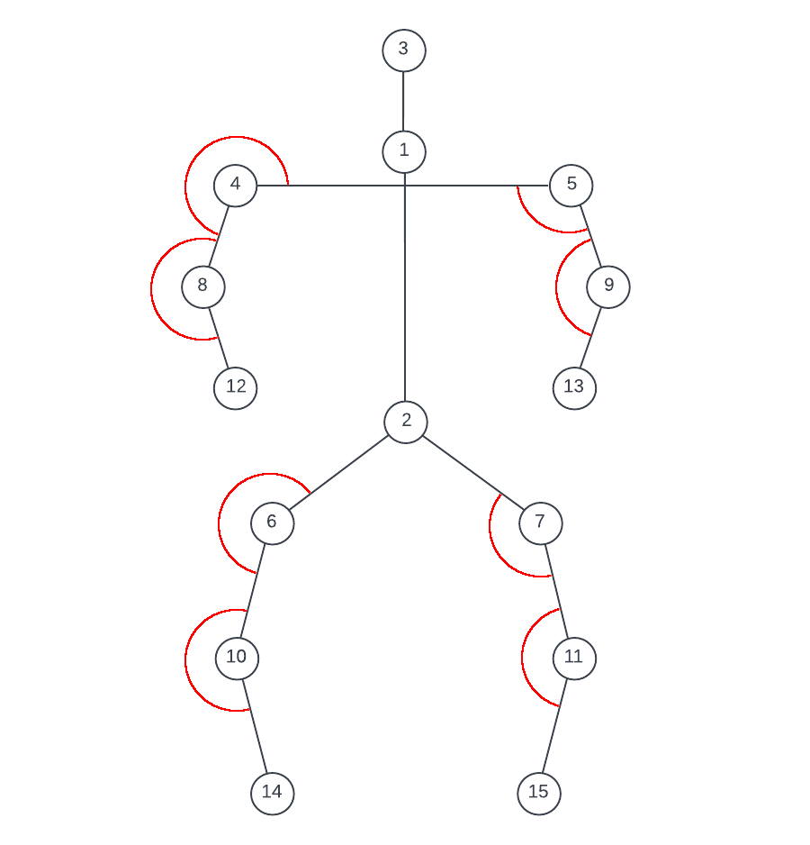
Joint Angles
Our primary goal:
Create a representation based on pose that is resistant to background interference
Solution:
Do not use joint positions, use joint angles
Notes:
The solution to this problem is to use the joint angles rather than the positions themselves
This is better overall as it will be the same regardless of the global positon of the person within the frame, and is robust to things like unintended camera movements

Slide 13
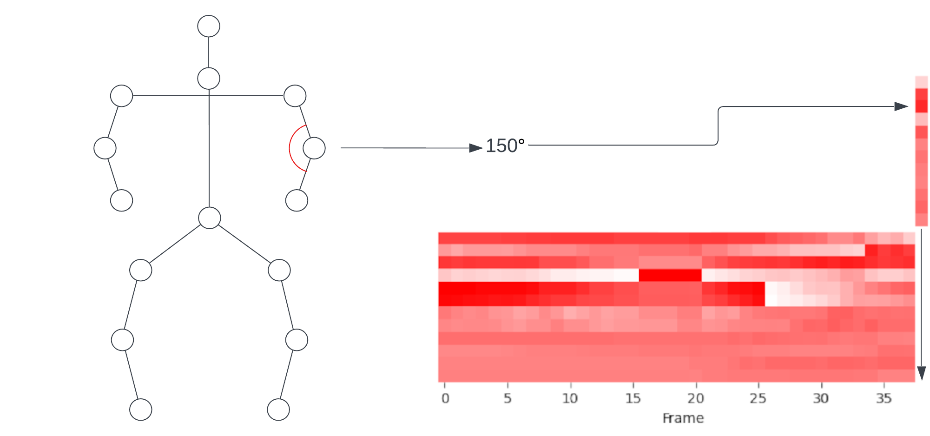
Intermediate Representation
We can take these joint angles from each frame and construct our intermediate representation
Very similar to the EHPI construction, however it is not as vulnerable to the x and y positions of the person in the frame
Notes:
Similar to the EHPI representation, we can use these joint angles to construct an image, for our purposes we only need one channel being the angle of the joint at any given frame

Slide 14
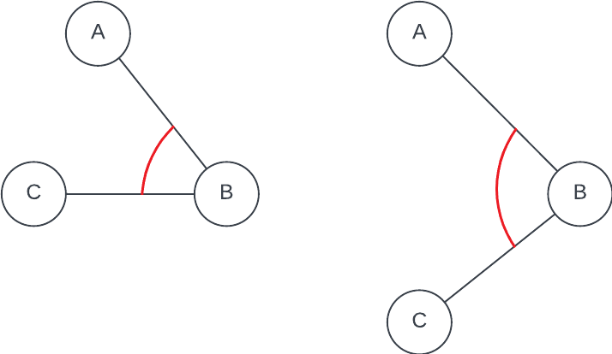
Joint Velocities
Notes:
In addition to this construction, we also add a temporal element to the representation.
For each frame i, we take the difference of the angle between frame i and i+1 and add that to the representation as the joint ‘velocity’ for that particular frame
This is stacked above the joints to provide us with a completed, stacked representation of one image for a video

Slide 15
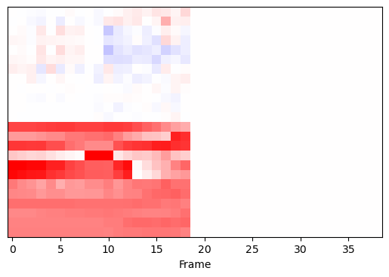
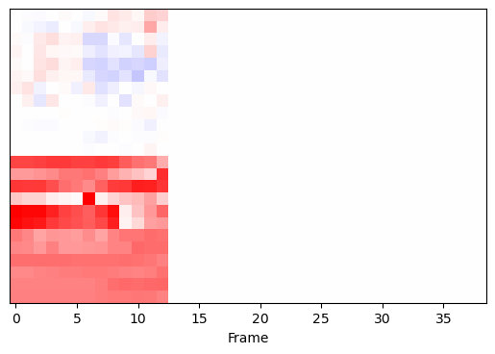
Temporal Adjustments
N=1
N=2
Notes:
We can also add further temporal adjustments
In these examples, we define a ‘skip’ value N, and the representation skips N frames in between each step, meaning instead of going from frame 1,2,3 we would go from 1,3,5 in the case of N=1 or 1,4,7 in the case of N=2
This skipping of frames results in long actions being more obviously defined in the representation, particularly in the case of the joint velocities.

Slide 16
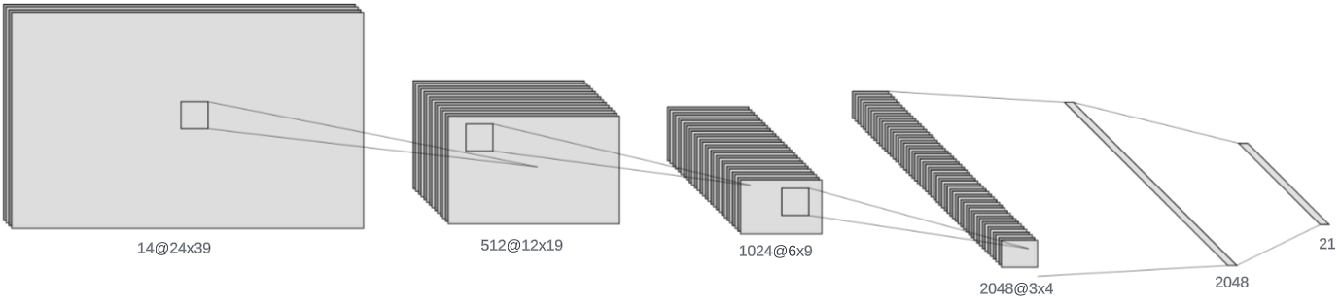
CNN Model Architecture
Notes:
After processing this representation, we can then simply pass it through a 2 dimensional CNN
This architecture is rather unremarkable, and only contains 4 convolution blocks, followed by a global average pooling and 2 fully connected layers, which is very common in domains such as image analysis

Slide 17
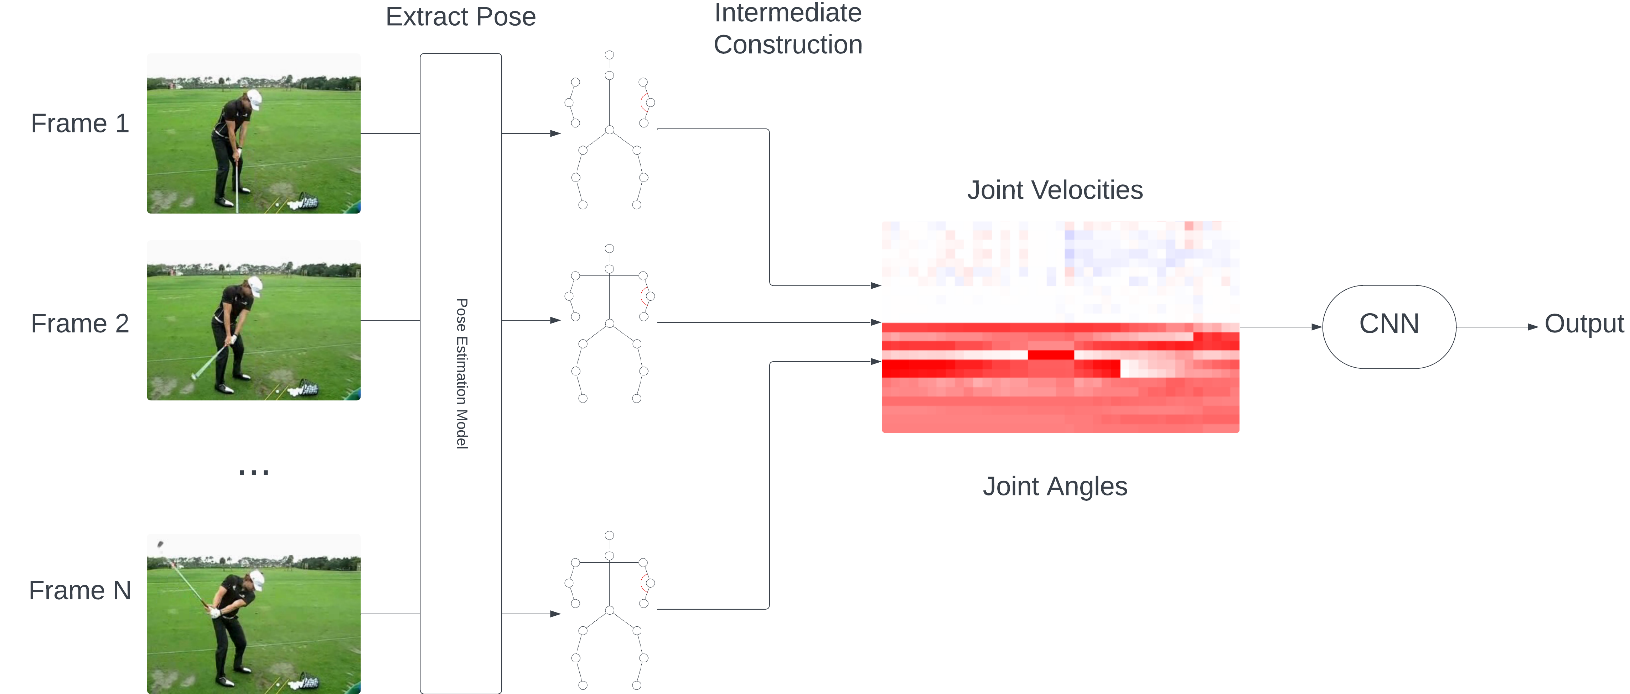
Full Architecture
Notes:
After putting all of the pieces together, we obtain the following full architecture, our video is passed through some pose estimation model first, which then gives us the corresponding pose
We then take that pose, or more specifically the joint angles of said pose and create our intermediate representation
Once we have created the representation, along with the corresponding temporal adjustment ones spoke about earlier, we take it and pass it through a simple cnn which gives us an output

Slide 18
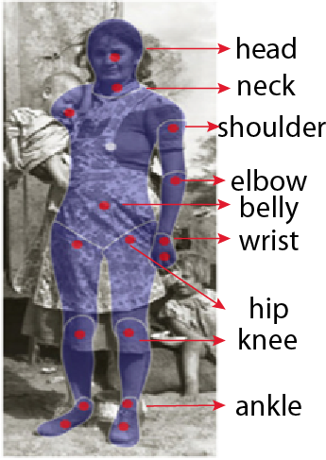
Dataset – JHMDB
JHMDB dataset was chosen for the manually annotated poses
Allows for direct comparisons with other models without considering the pose models being used, means we can ‘isolate’ the techniques used for action recognition
Dataset contains:
21 Classes
36-55 clips per action, 928 total
3 Training/Testing splits
Notes:
As for the dataset we will be working with I have chosen JHMDB
JHMDB is actually a subset of another dataset known as HMDB which is a rather complex action recognition dataset
JHMDB provides these manually annotated skeletons for each of the 900 or so clips which gives us an advantage of not having to consider different pose models and how they may affect the model
It also allows us to more accurately compare our model against similar techniques as there is not a question of how much inaccuracy would be a result of the pose model vs the intermediate representation
The actual dataset contains 21 classes split into 3 different training/testing splits, so for each split we will be training on two of them and reporting test results on the third

Slide 19
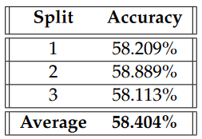
Results
Notes:
So, here are the results for the model on the JHMDB dataset, on average we achieve about a 58% accuracy for each split, remaining consistent through each of them, however this does not tell the full story

Slide 20
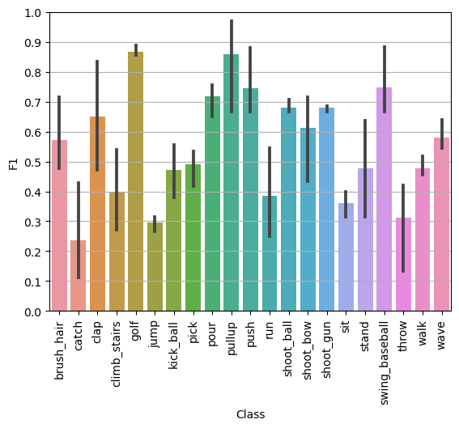
Results
Notes:
This is the detailed breakdown of the F1 score of each class,
as you can see there are some classes where the model performs quite well such as golf, pour, pullup, push and swing baseball
There are also some classes where the model performs very poorly, such as catch, jump, climb_stairs, and sit
For the purposes of this presentation, I’ll be looking more in detail at three of the classes, catch, jump and golf and why the accuracy was high or low

Slide 21
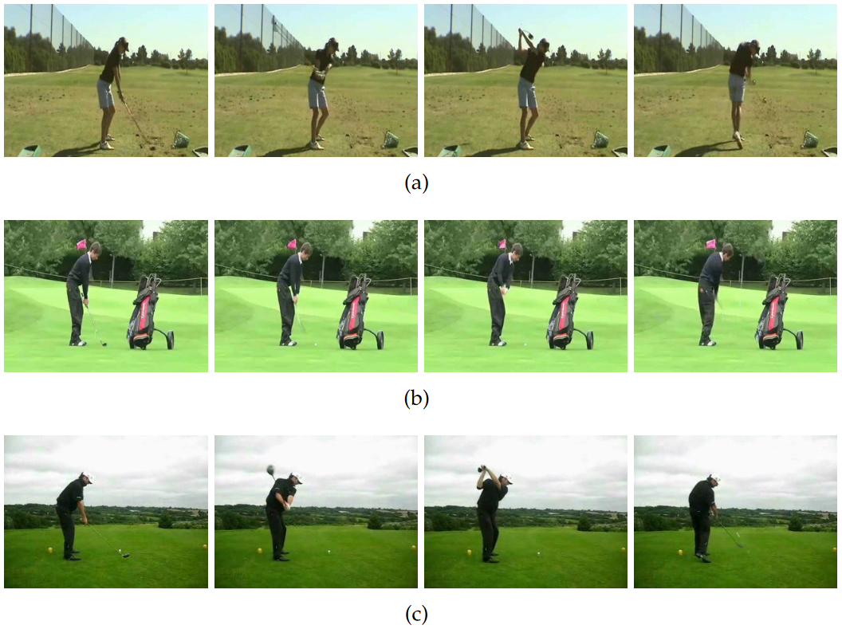
Golf Action – Consistent Movement ~85% F1
Notes:
Our first example is the golf class
The model performed quite well when considering this class, achieving approximately 85% F1 score
The reason for this is primarily the consistent movement from one person to another when swinging a golf club.
Taking a look at the examples presented here, these are four subsampled frames of approximately similar points within someone’s golf swing action.
Examples a and c show a very similar swing, whereas example b shows a slightly smaller swing, but overall all of these actions are performed in nearly the same way, thus meaning that our representation will be built in nearly the same way, making generalizing easier for us when moving from one person to another

Slide 22
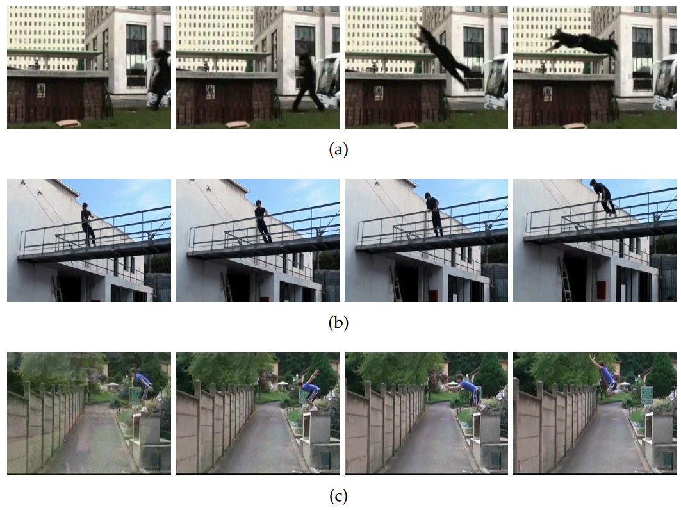
Jump Action – Global Position Change ~30% F1
Notes:
The Jump action is an example of when things begin to become rather difficult
The first and perhaps most glaring issue with this action is that the person jumping typically moves through the frame globally. Taking examples a and c, we can see that the person is moving from the right side of the frame towards the left, something that was intentionally avoided by our model to make it so that camera movements would not affect it nearly as much, but causes issues because it is not able to interpret the movement of the person throughout the video globally.
Example b does not show this same movement throughout the frame, but shows another issue, where the movement of a person performing the ‘jump’ action is not nearly consistent enough from one person to another to make using only the joint angles viable to obtain high quality results

Slide 23
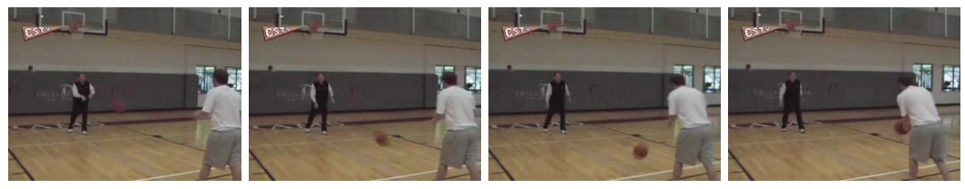
Catch – Object Interaction ~25% F1
Notes:
The catch action shows another issue present in this kind of model.
In this example, we can see that the person on the right is the one performing the action, they lean forward slightly and catch the ball.
The issue with this is that our model cannot detect that they have just caught a ball, it only sees this slightly leaning forward motion which is difficult to discern what is happening.
So by completely eliminating the background interference, we have to acknowledge that we are also removing potentially important data relevant to the actions, such as objects they may be interacting with

Slide 24
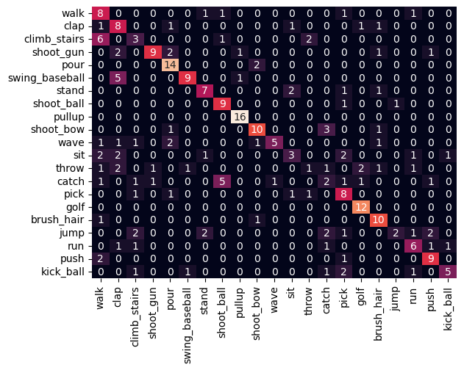
Results - Confusion Matrix
Notes:
This is the confusion matrix for the first split of the jhmdb dataset
We can see that there are a couple of cases of class confusion that arise from issues previously discussed, as well as simply similar actions, such as swing baseball and clap, catch and shoot ball and the example we will take a closer look at, climb stairs and walk

Slide 25
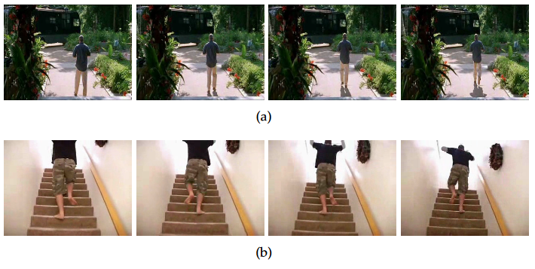
Class Confusion – Walk vs Climb Stairs
Notes:
For this example, it is again an issue of global positioning and background context clues.
While there are some slight differences, the walking and climbing stairs look rather similar in person movements alone, the primary issue being our model cannot pick out the background context of a set of stairs or the movement of a person up the stairs globally within the frame, leading to significant class confusion between these two

Slide 26
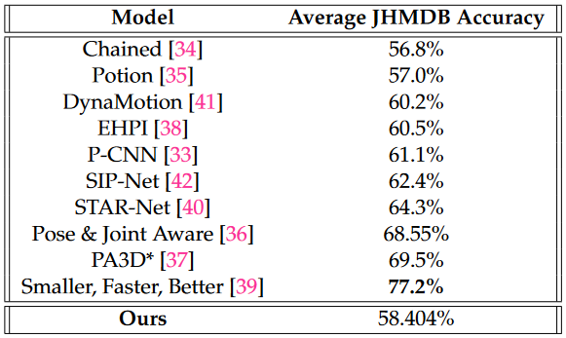
Model Comparison
Notes:
Comparing our model to other pose-based models, we end up in the slightly lower end, slightly above the potion model spoken about earlier, with some models achieving significantly greater results
However it is worth noting that these models generally use the global position of someone throughout the frame and are thus more vulnerable to background interference than ours

Slide 27
Results Summary
Our model is not state-of-the-art
Aim to fill a specific niche
Lightweight, very simple models for movement-based actions
Agnostic to global position, scale and rotation
With that comes sacrifices
Global position means we cannot track person moving through the frame
Pose-exclusive model means we cannot see any objects that the person might be interacting with
Notes:
So to summarize the results and comparisons, our model is not going to be state of the art in it’s current form
Instead it aims to fill a specific niche of a lightweight pose based model that is agnostic to global position, scale or rotation fo the person and with those advantages comes some sacrifices towards particular actions that require background information or global position information

Slide 28
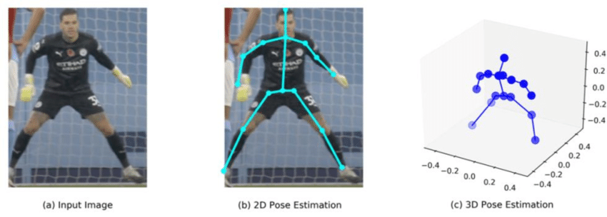
Future Work
Moving from 2-dimensional skeletons to 3-dimensional
Truly camera agnostic
Notes:
Primary goal would be to apply some logic to 3d skeletons
Would require some work as the current logic is based on 2d angles
Additional work could be to add this intermediate representation to an existing model to attempt to increase performance

Slide 29
Thank You!

